Slide 1

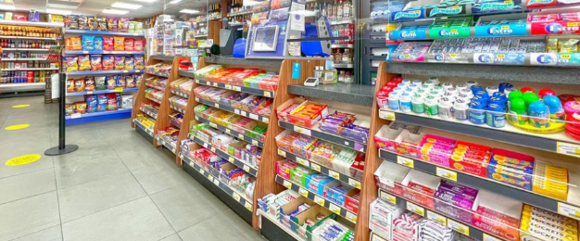
Super Store Sales

Slide 2
Team Members
Youssef Mostafa
Hossam Gamal
Ahmed Mahmoud
Ehab Sobh

Slide 3
Table of contents
Introduction
Customer Insights
Product Performance
Shipping Analysis
Regional Performance
Cleaning
Modeling
Sales Analysis

Slide 4
Introduction
Overview of the Superstore Sales Dataset
Business Objectives & Data Scope

Slide 5
Cleaning

Slide 6
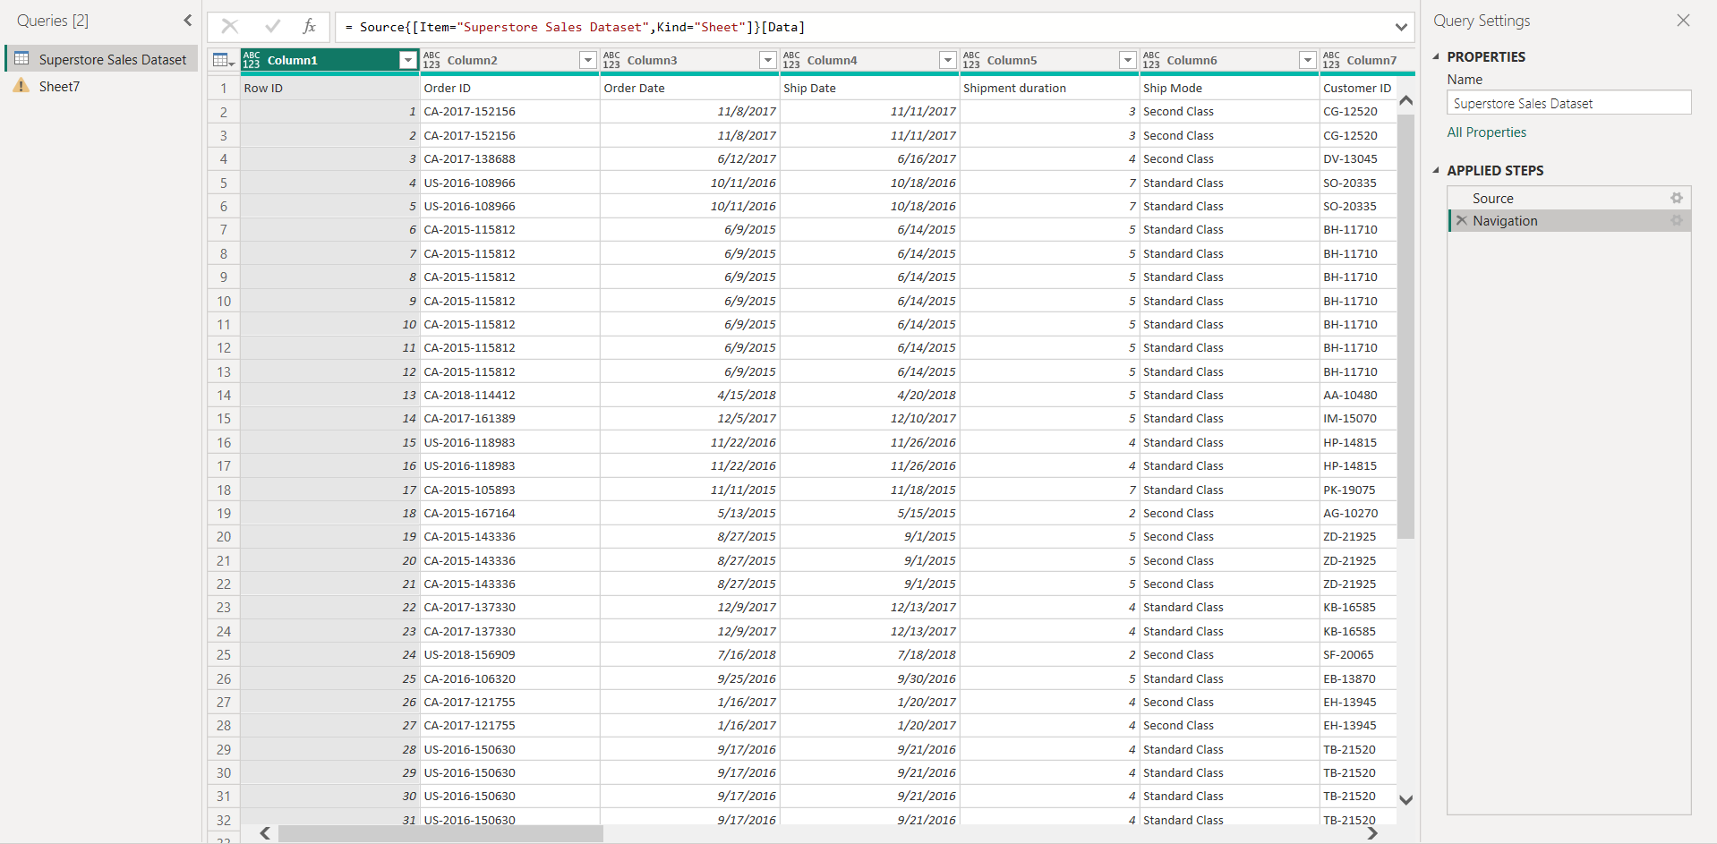
Before

Slide 7
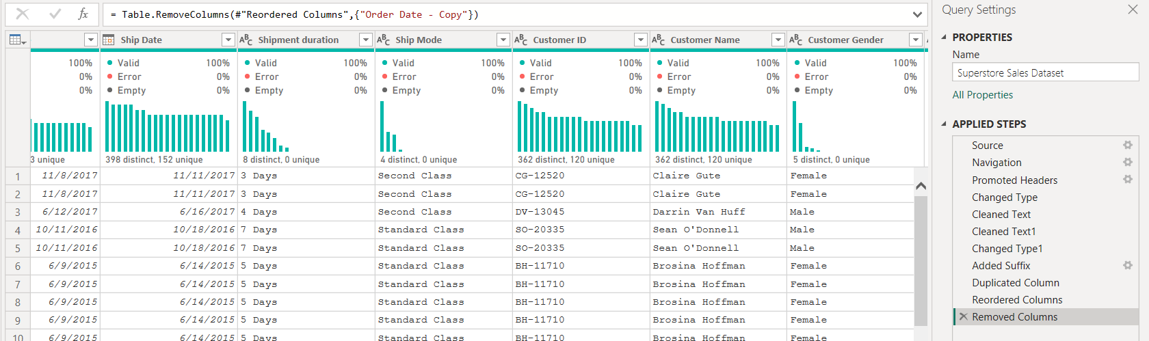
After

Slide 8
Sales Analysis
📊 Total sales and average order value
01
📆 Sales trends over time (monthly or yearly)
02
🗺️ Sales by Region and State
03
🛍️ Sales by Category and Sub-Category
04
💰 Identify seasonal patterns or growth trends
05

Slide 9
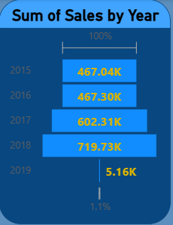
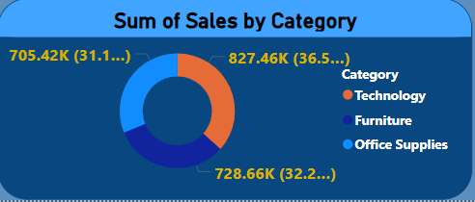
Sales Analysis

Slide 10
Customer Insights
👥 Customer segmentation (Consumer, Corporate)
🚻 Sales by gender
💎 Top customers by revenue and order frequency
🧭 Customer distribution by region

Slide 11
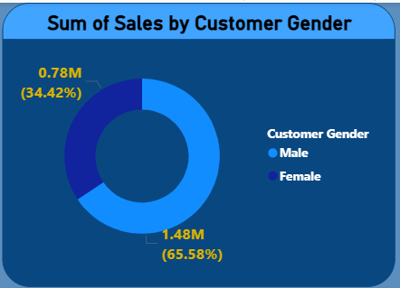
Customer Insights

Slide 12
Product Performance
Content for this slide:
🏆 Top-selling products by revenue
📦 Sales vs. quantity sold
💸 Profitability by category or sub-category
📉 Identify low-performing products for improvement
Charts to Include:
Bar chart: Sales by product
Tree map: Profit by category
Scatter plot: Sales vs. profit

Slide 13
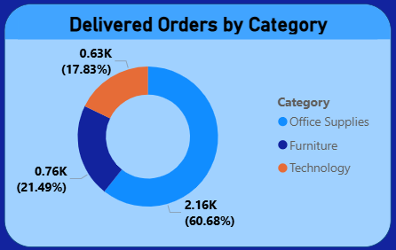
Product Performance

Slide 14
Shipping Analysis
Content for this slide:
🚚 Shipping modes (Standard, Second Class, First Class, Same Day)
⏱ Average shipment duration by mode
📦 Relationship between shipment duration and sales value
🧾 Cost efficiency of different shipping methods
Charts to Include:
Bar chart: Shipment duration by mode
Line chart: Delivery times trend

Slide 15
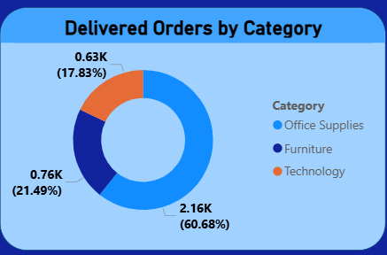
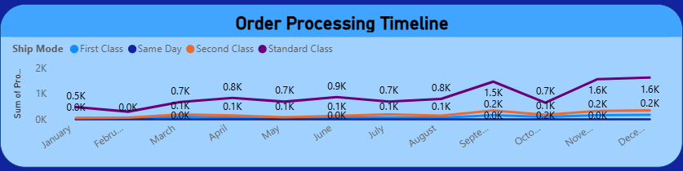
Shipping Analysis

Slide 16
Regional Performance
Content for this slide:
🗺️ Regional sales comparison (East, West, Central, South)
💲 Top states and cities by revenue
📈 Growth potential by region
⚖️ Regional contribution to total sales
Charts to Include:
Map visualization: Sales by region
Column chart: Top 10 states by sales

Slide 17
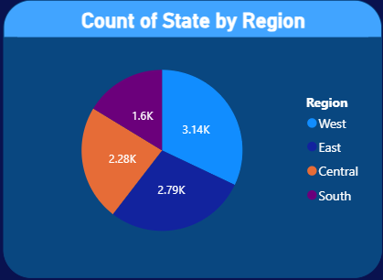
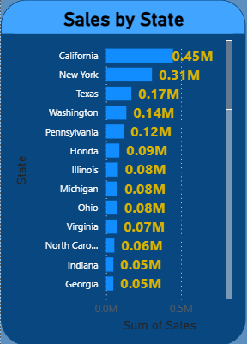
Regional Performance

Slide 18


Microsoft Power BI

Slide 19
Microsoft Power BI

Slide 20
Microsoft Power BI

Slide 21
Microsoft Power BI

Slide 22
Microsoft Power BI

